Slide 1

Surface Hub 2S Office 365 Guide

Slide 2
Table of contents
Sign in to Office 365 – Access your files across apps
Microsoft PowerPoint – Create and annotate on dynamic presentations
Microsoft Excel – Create and edit spreadsheets
Microsoft Word – Create and markup documents and contracts
Microsoft OneDrive – Access, manage, and share files

Slide 3
Sign in to Office 365
<- Back to Table of Contents

Slide 4
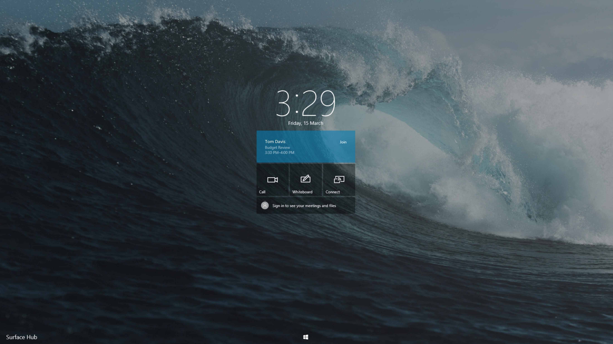
<- Back to Table of Contents

Slide 5
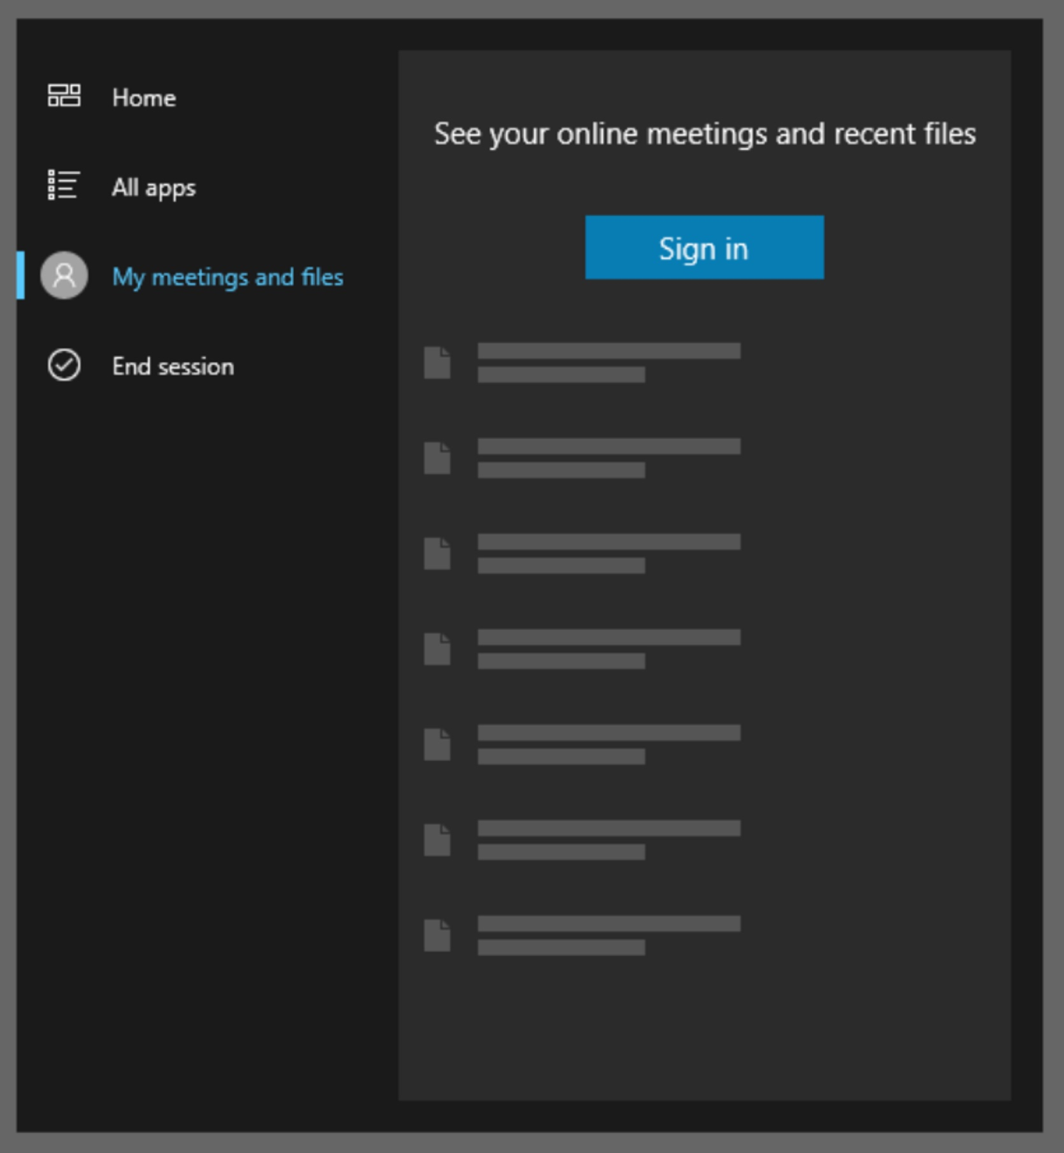

<- Back to Table of Contents

Slide 6
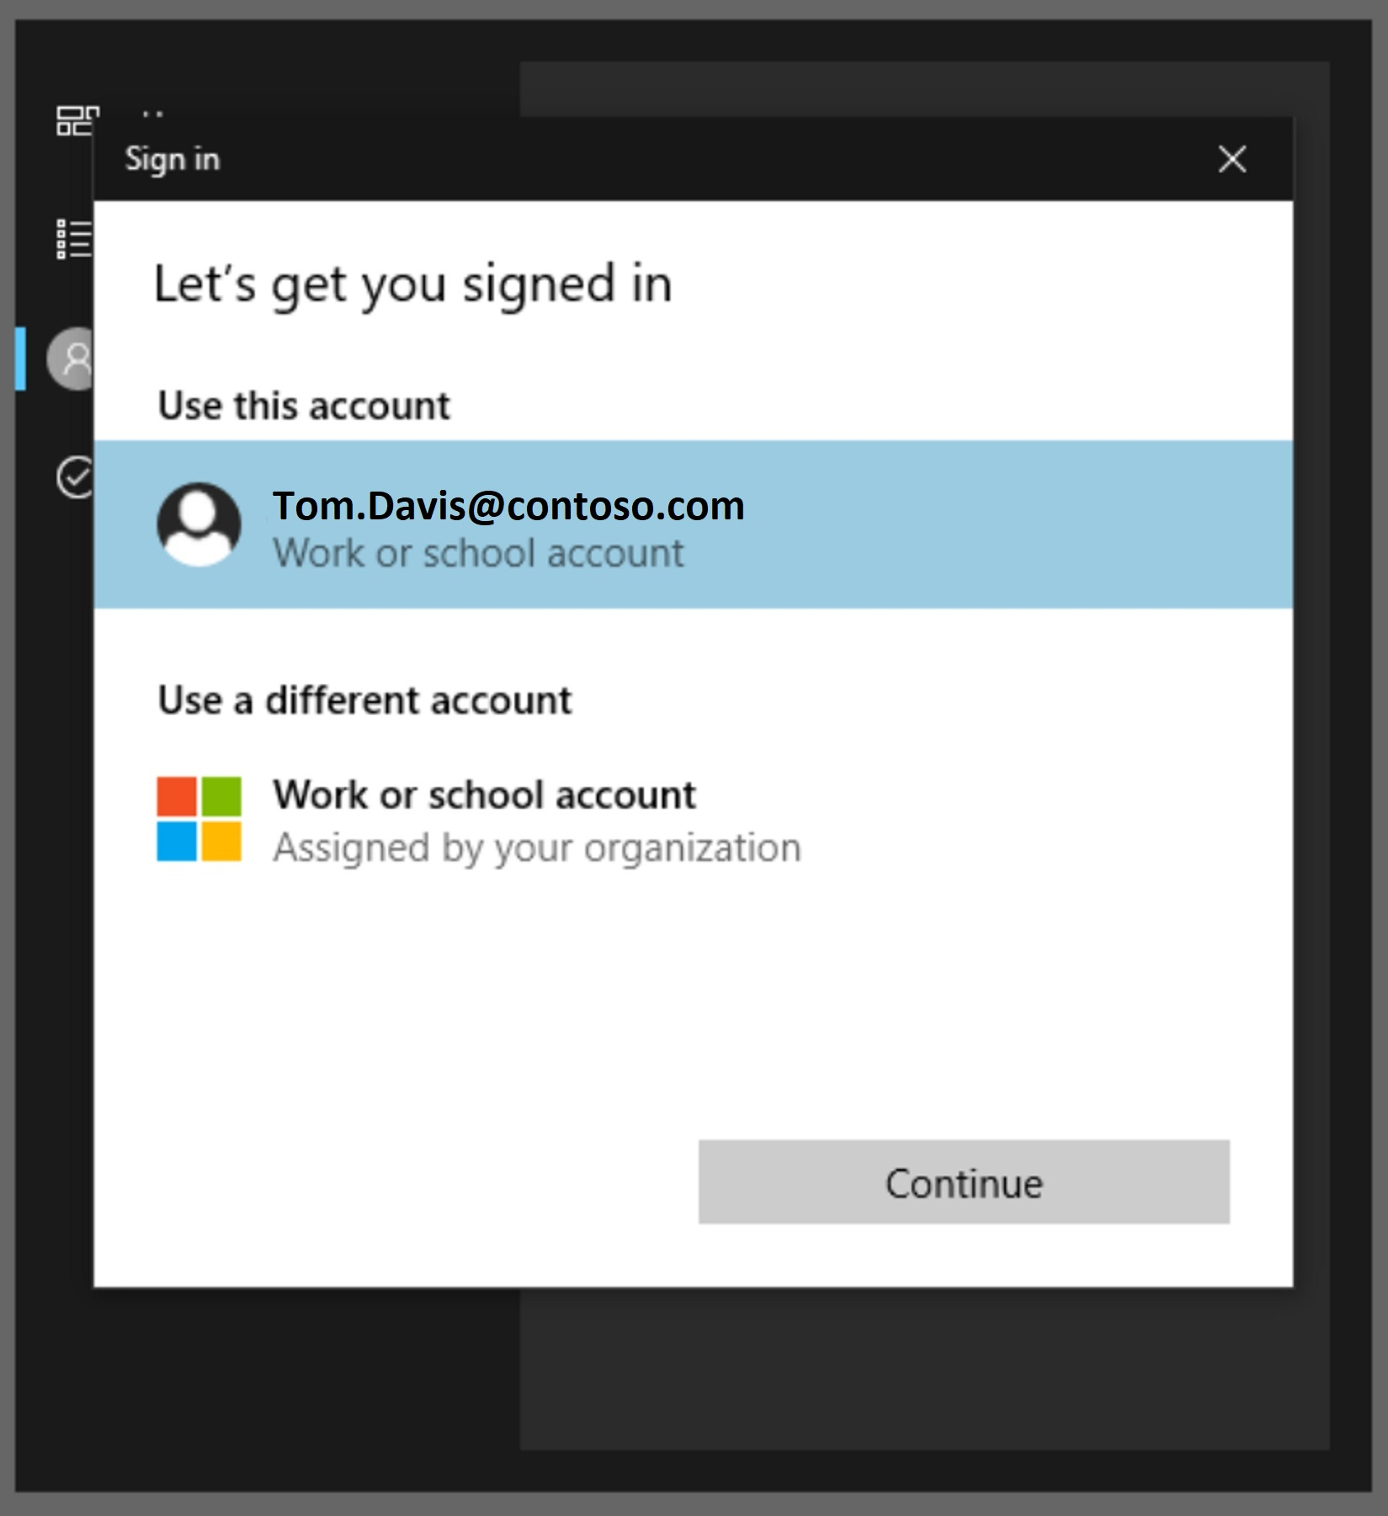
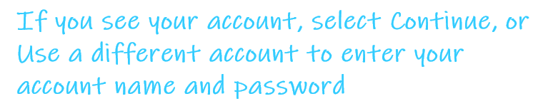
<- Back to Table of Contents

Slide 7
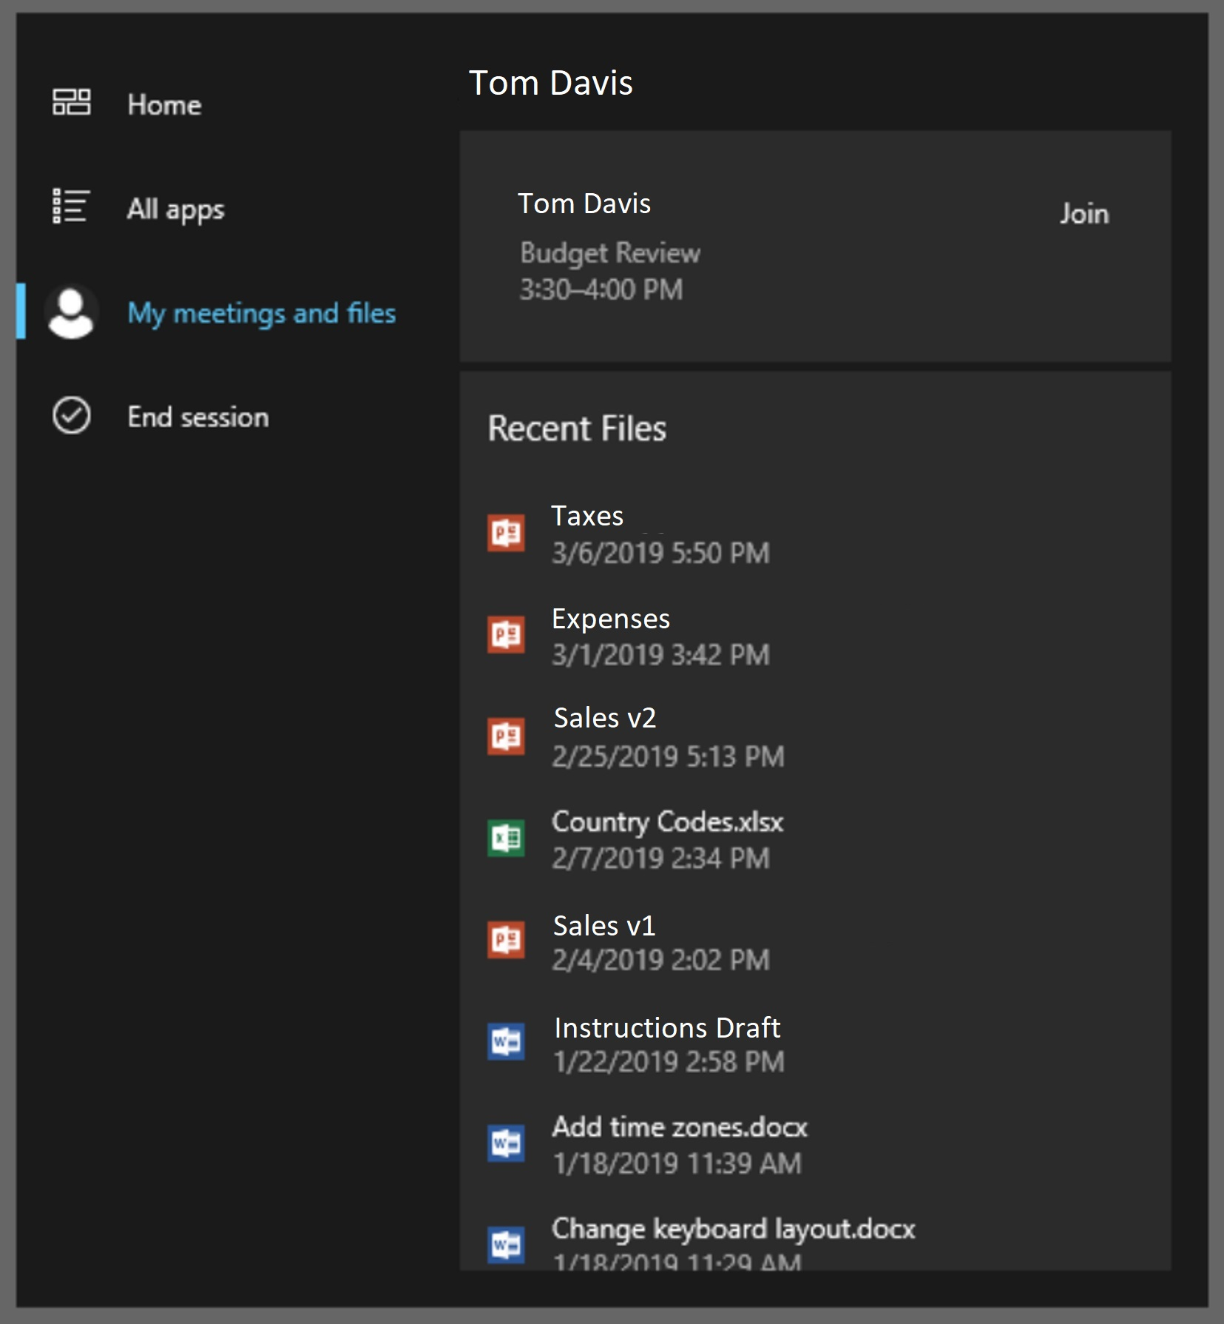

<- Back to Table of Contents

Slide 8
Microsoft PowerPoint
<- Back to Table of Contents

Slide 9
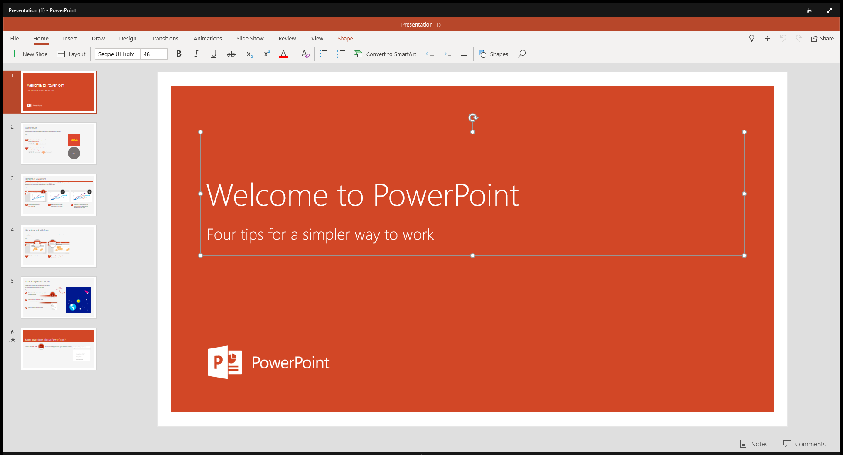
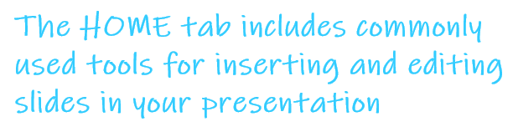
<- Back to Table of Contents

Slide 10

<- Back to Table of Contents

Slide 11
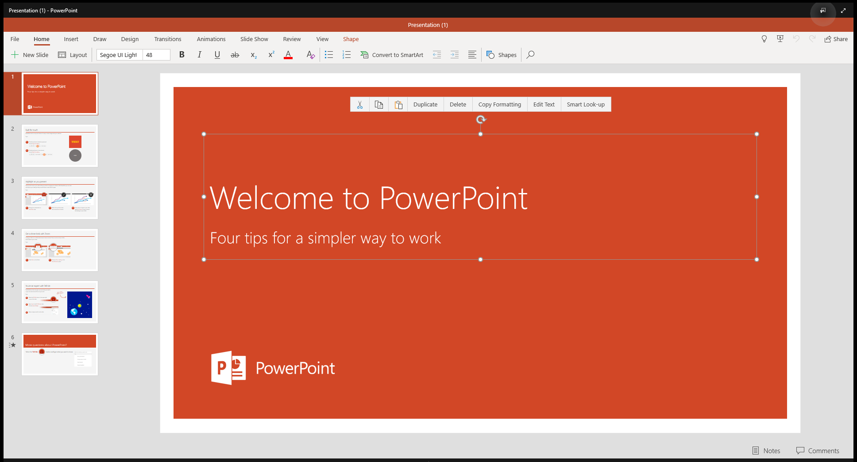
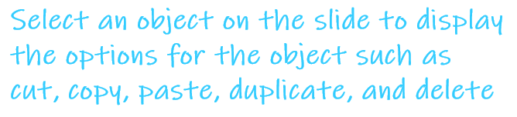
<- Back to Table of Contents

Slide 12

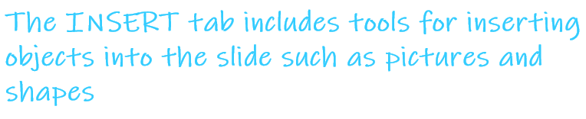
<- Back to Table of Contents

Slide 13


<- Back to Table of Contents

Slide 14


<- Back to Table of Contents

Slide 15
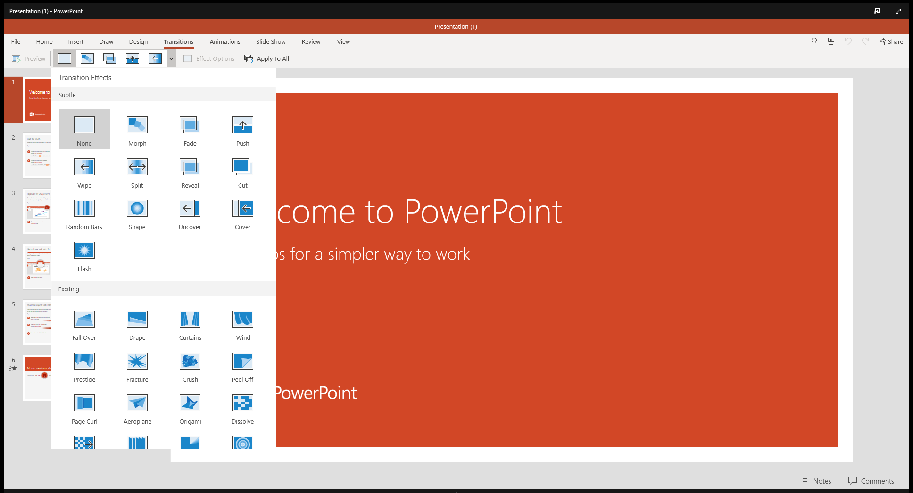
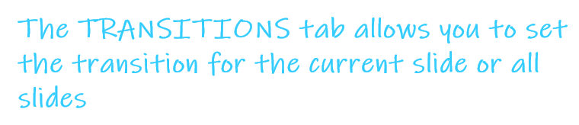
<- Back to Table of Contents

Slide 16
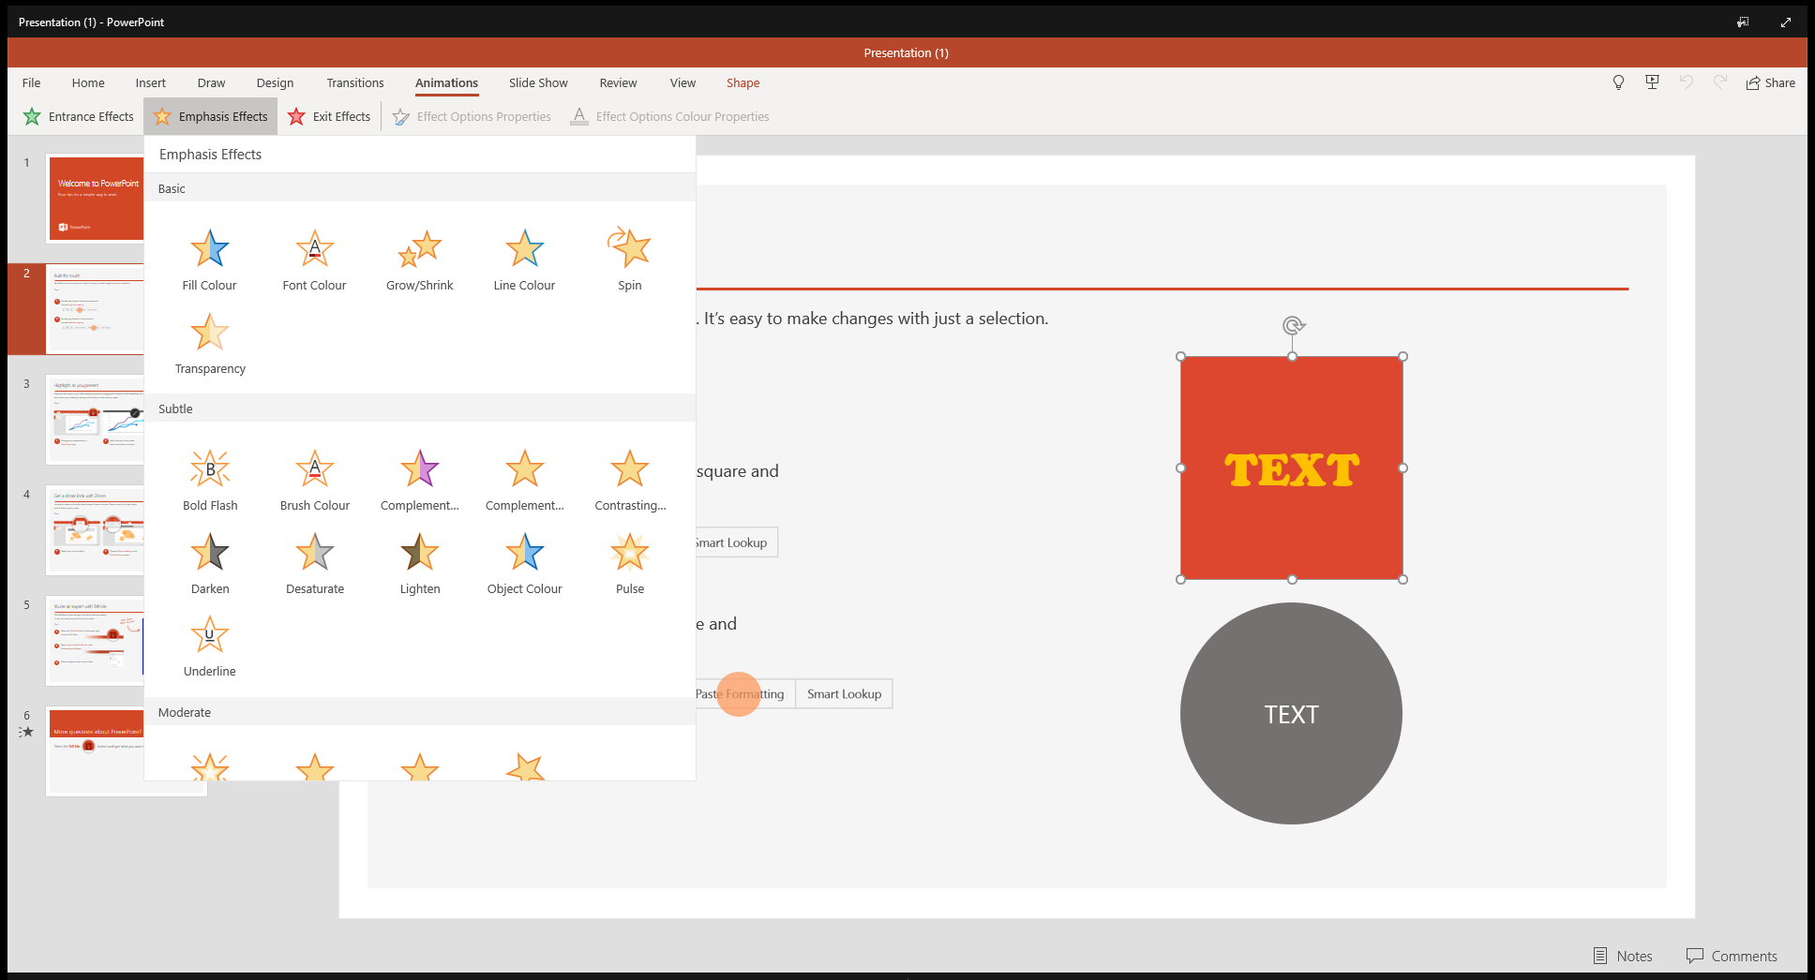

<- Back to Table of Contents

Slide 17
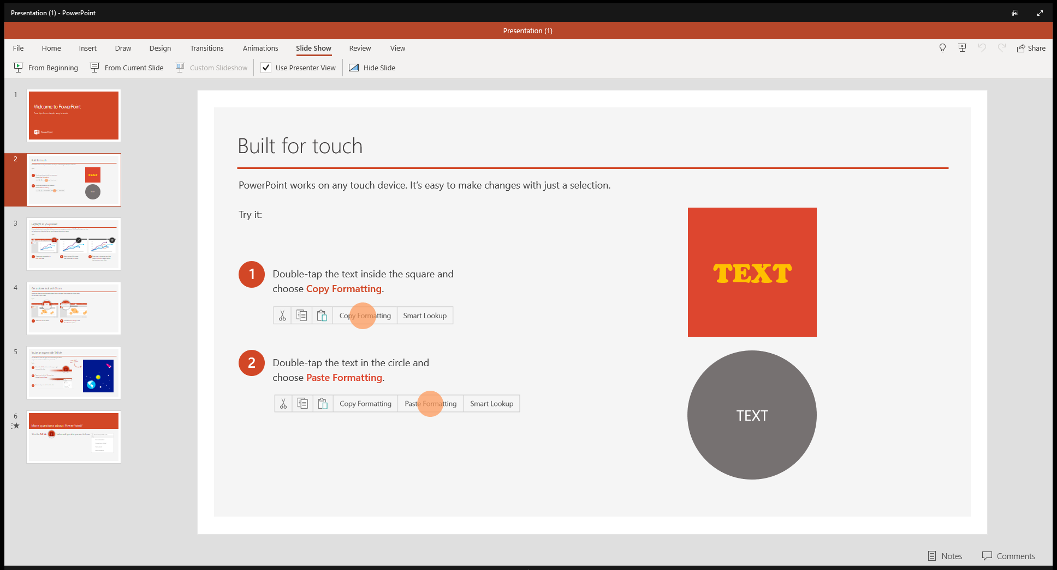
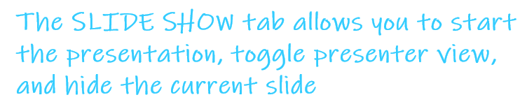
<- Back to Table of Contents

Slide 18
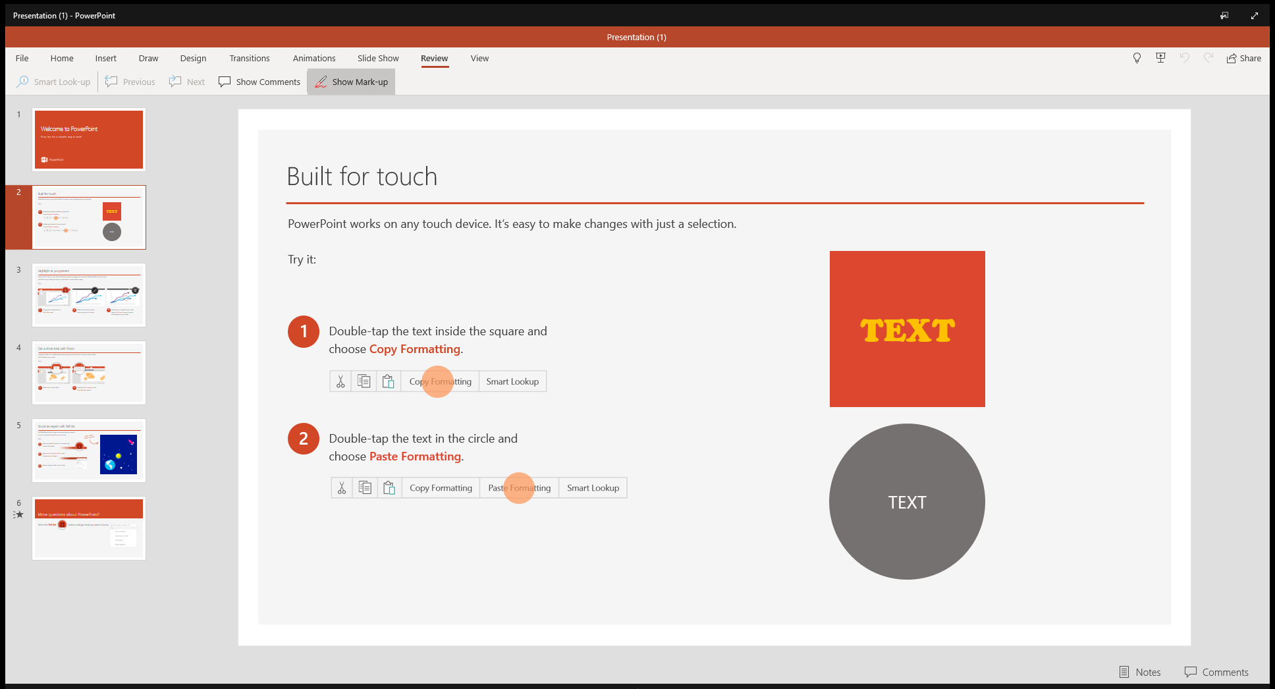

<- Back to Table of Contents

Slide 19

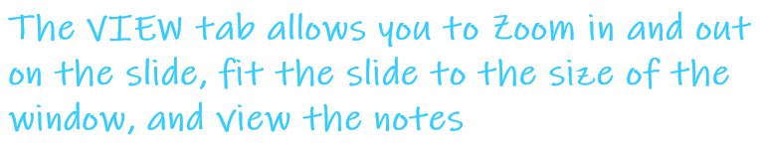
<- Back to Table of Contents

Slide 20


<- Back to Table of Contents

Slide 21
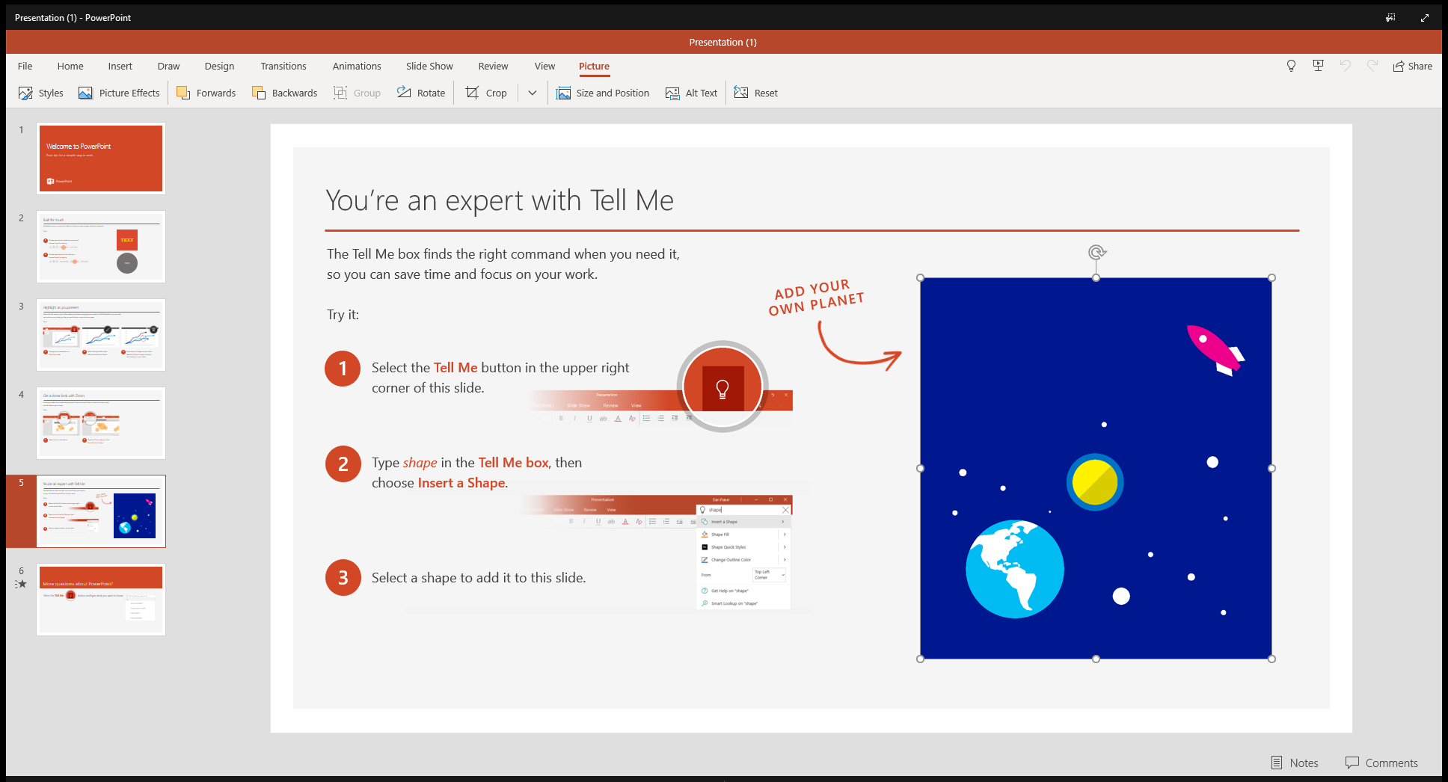

<- Back to Table of Contents

Slide 22
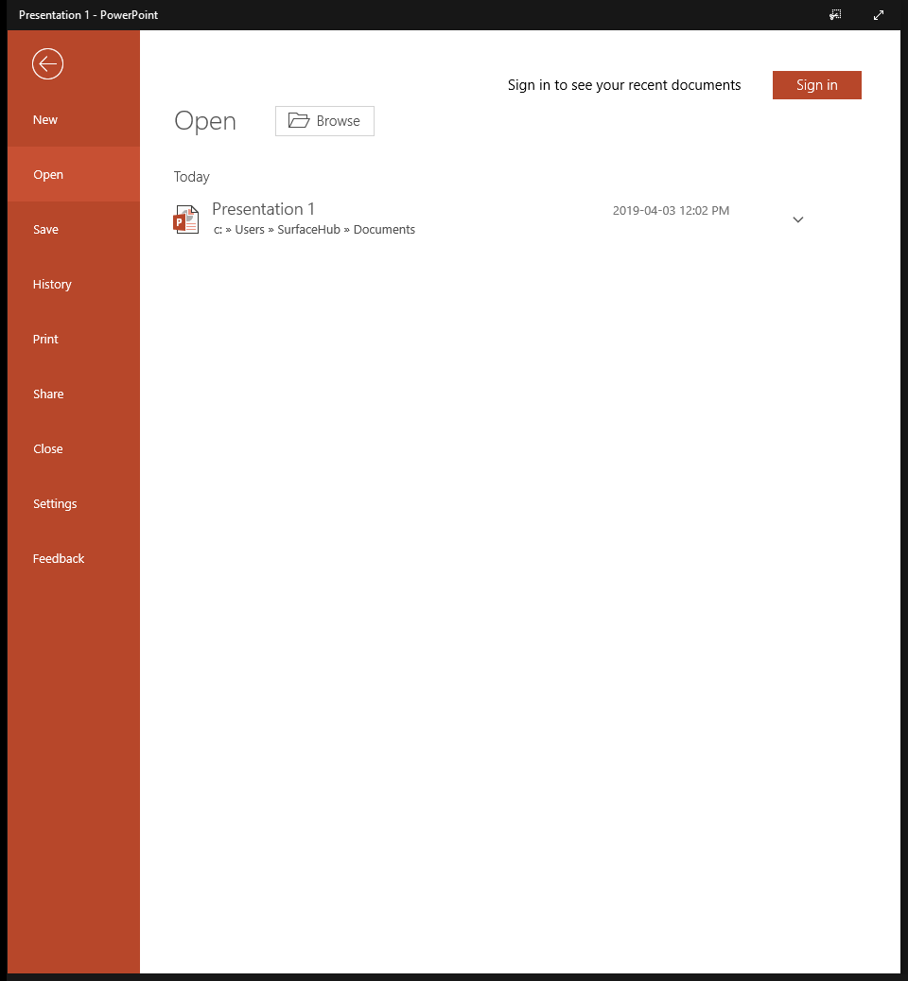


<- Back to Table of Contents

Slide 23
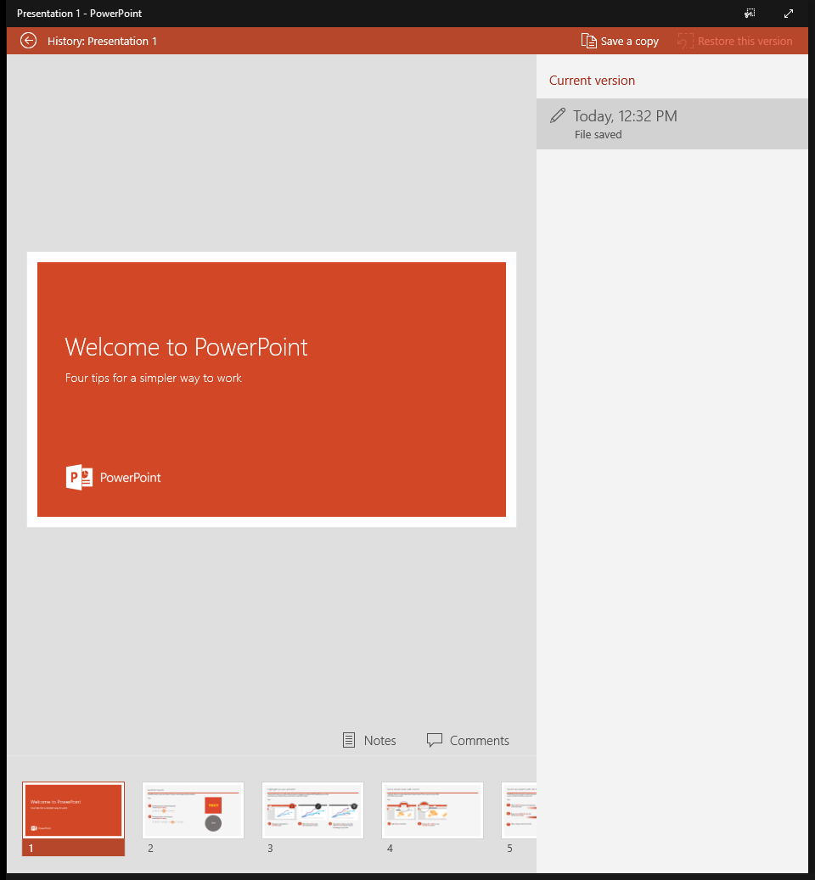

<- Back to Table of Contents

Slide 24
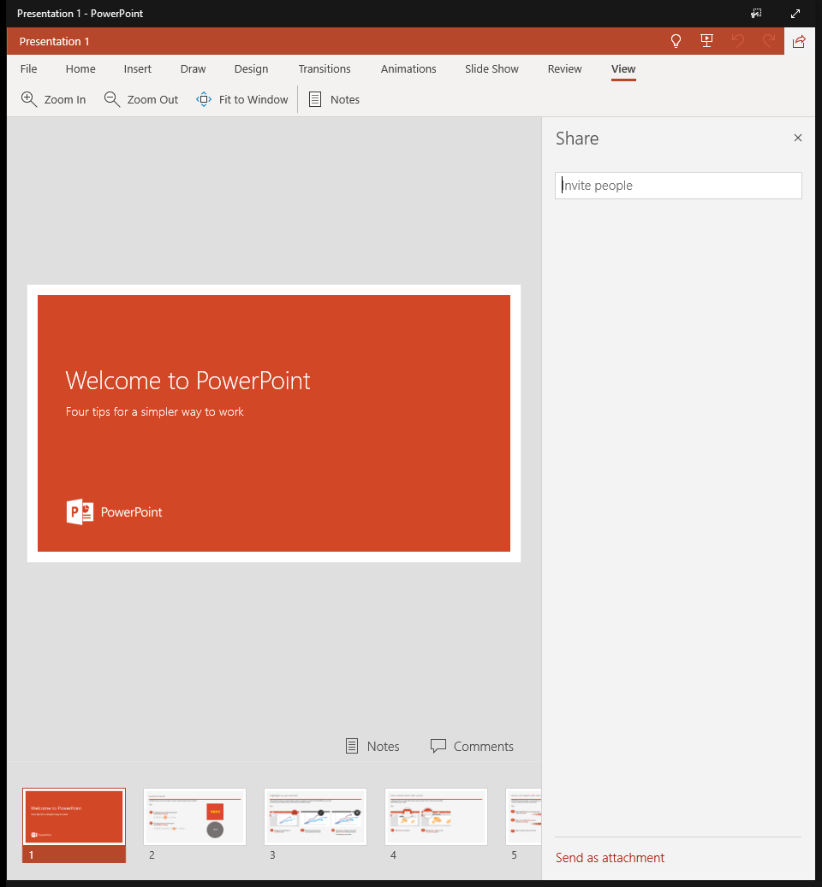
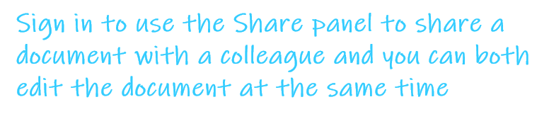
<- Back to Table of Contents

Slide 25
Microsoft Excel
<- Back to Table of Contents

Slide 26
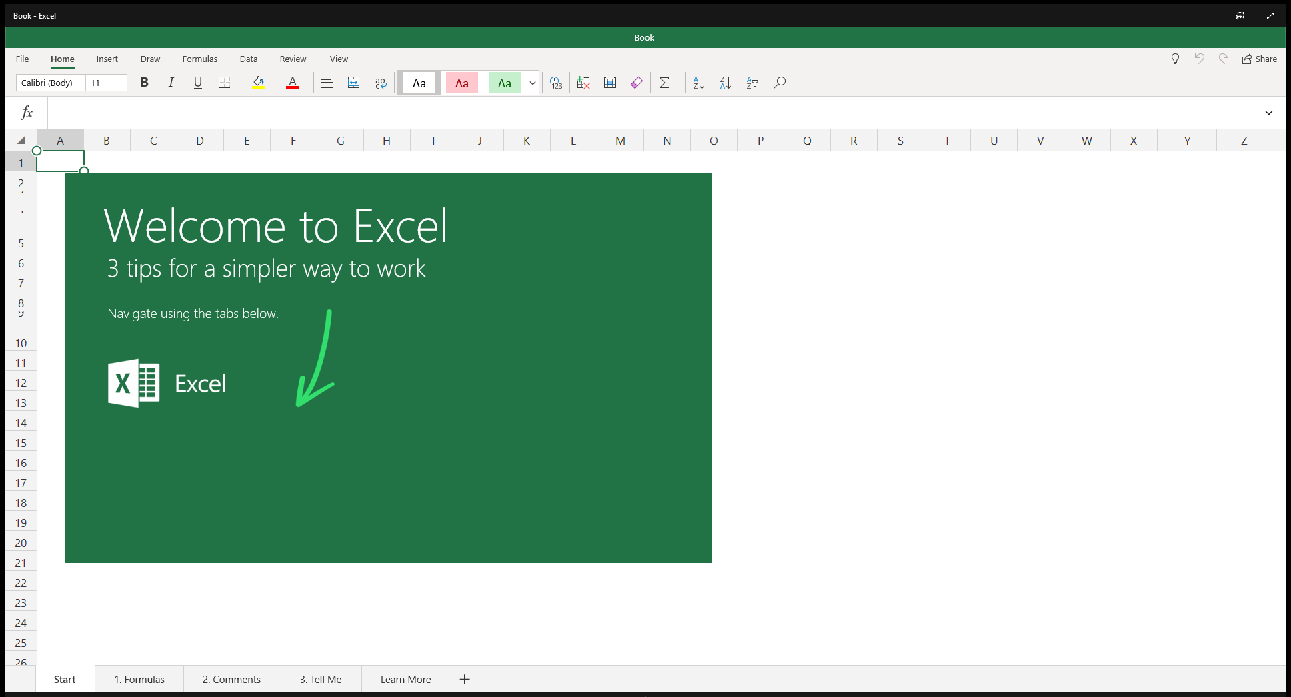

<- Back to Table of Contents

Slide 27

<- Back to Table of Contents

Slide 28
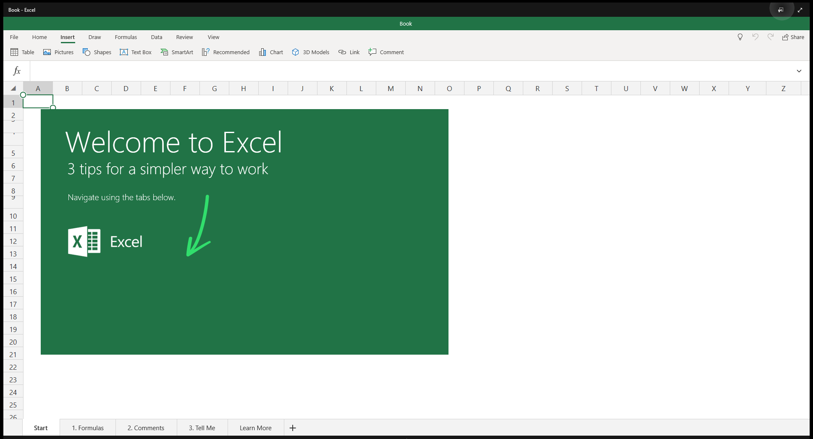

<- Back to Table of Contents

Slide 29


<- Back to Table of Contents

Slide 30


<- Back to Table of Contents

Slide 31
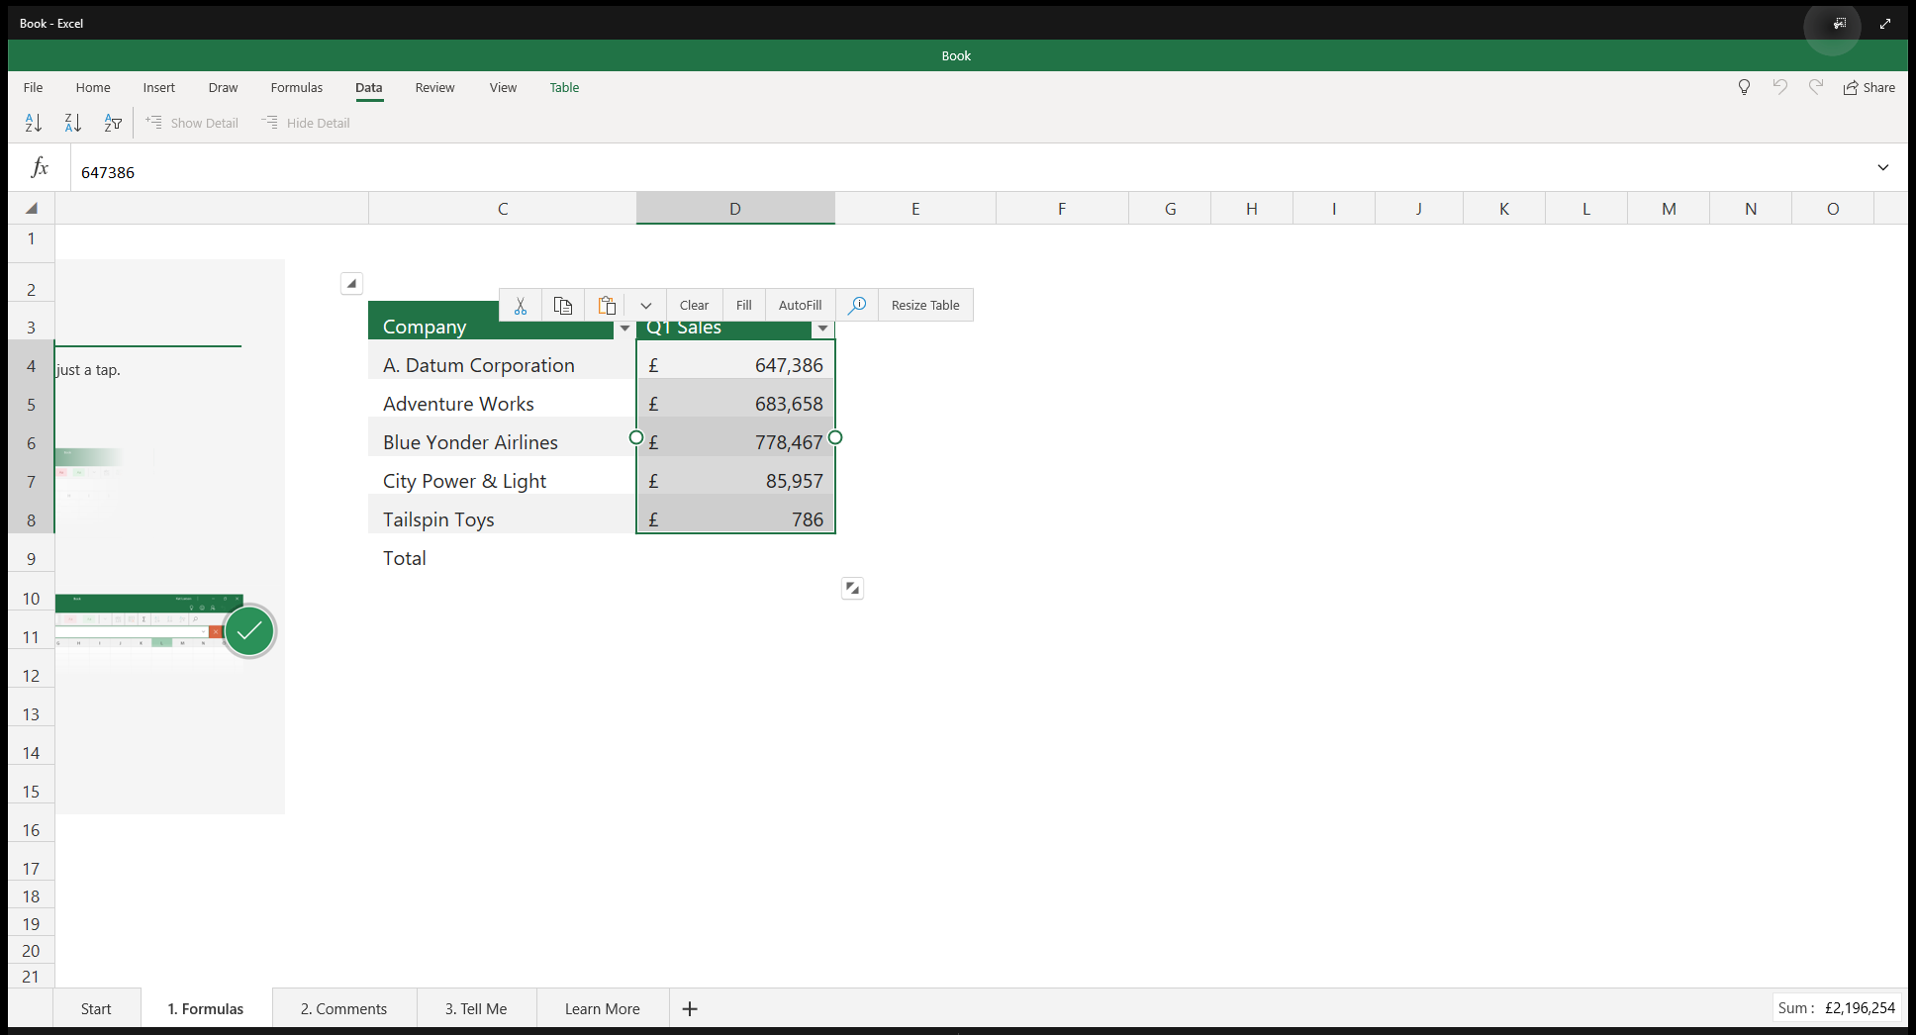

<- Back to Table of Contents

Slide 32

<- Back to Table of Contents

Slide 33


<- Back to Table of Contents

Slide 34
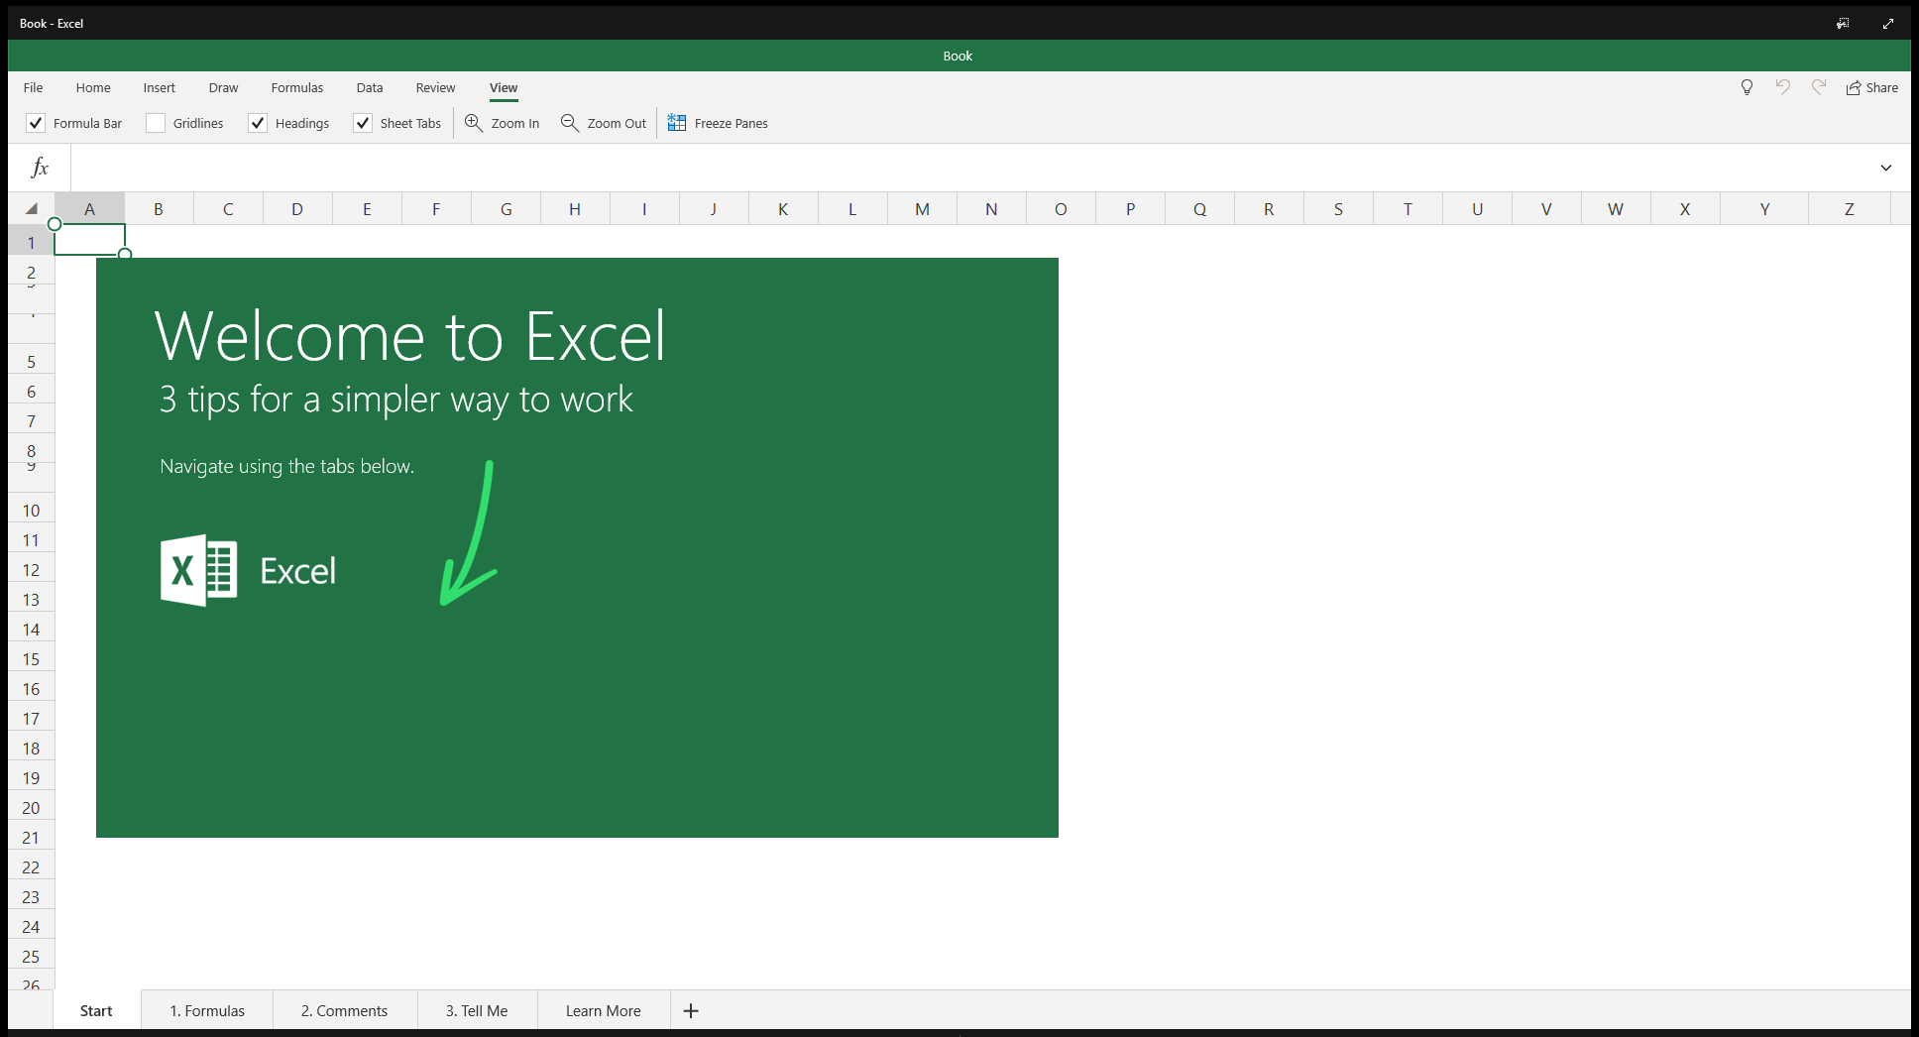
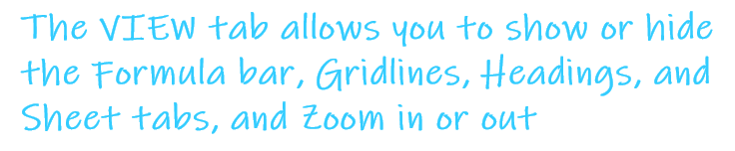
<- Back to Table of Contents

Slide 35
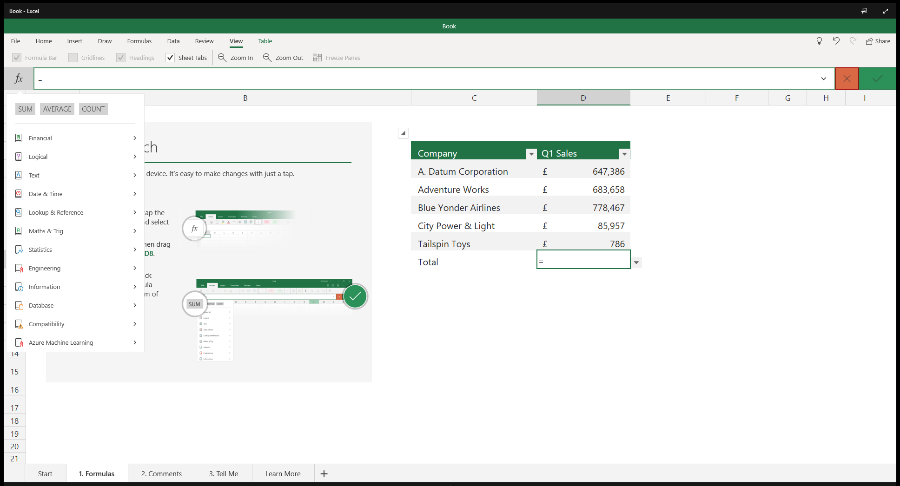

<- Back to Table of Contents

Slide 36
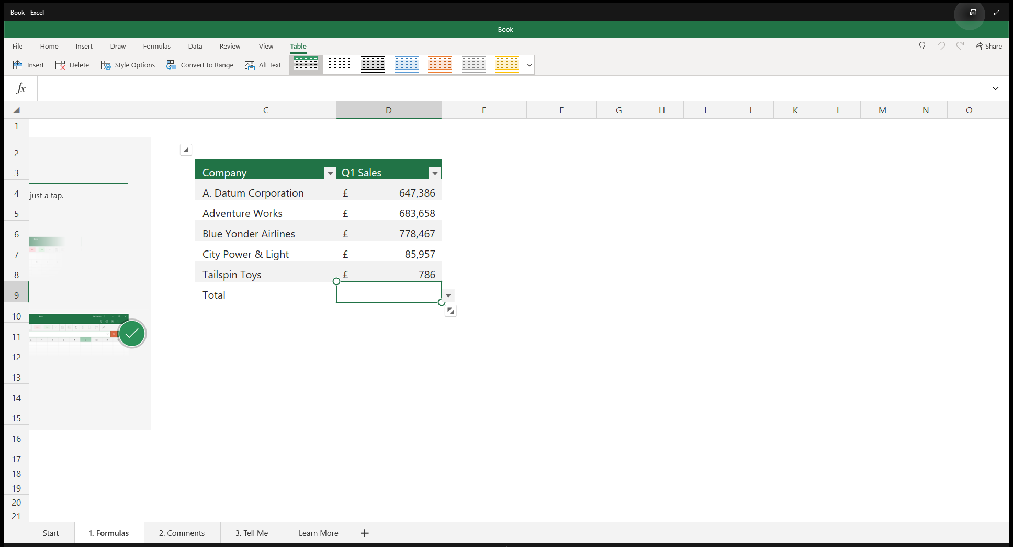

<- Back to Table of Contents

Slide 37
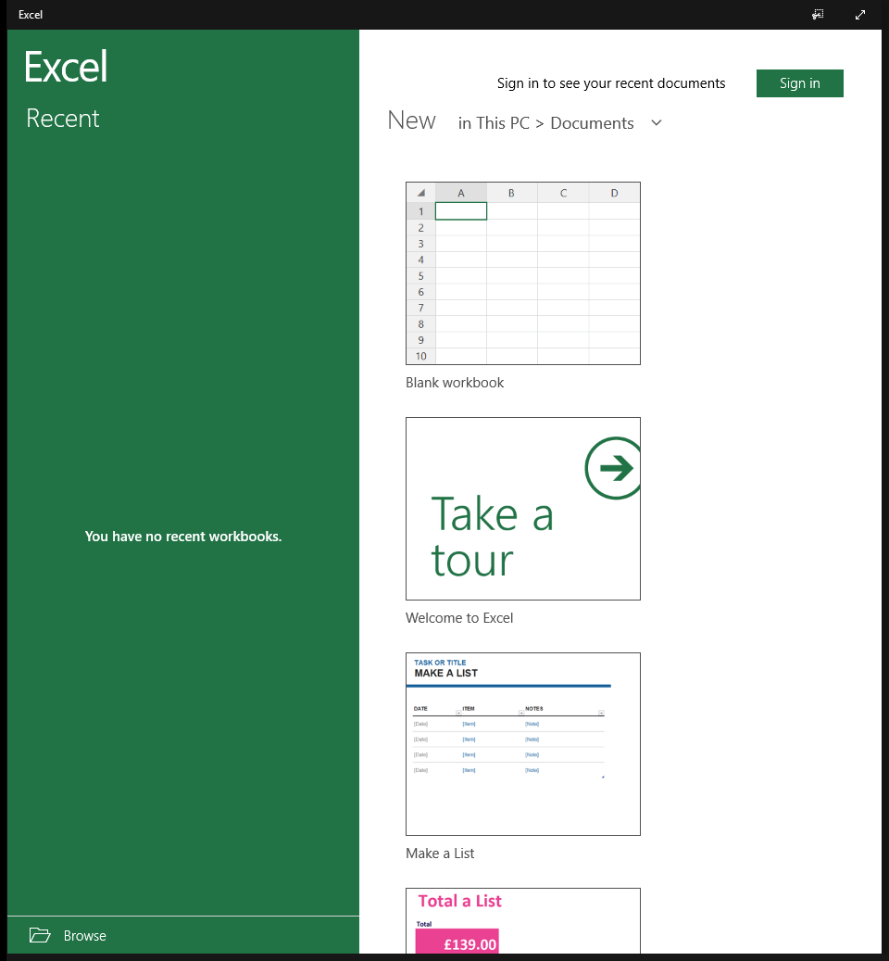

<- Back to Table of Contents

Slide 38
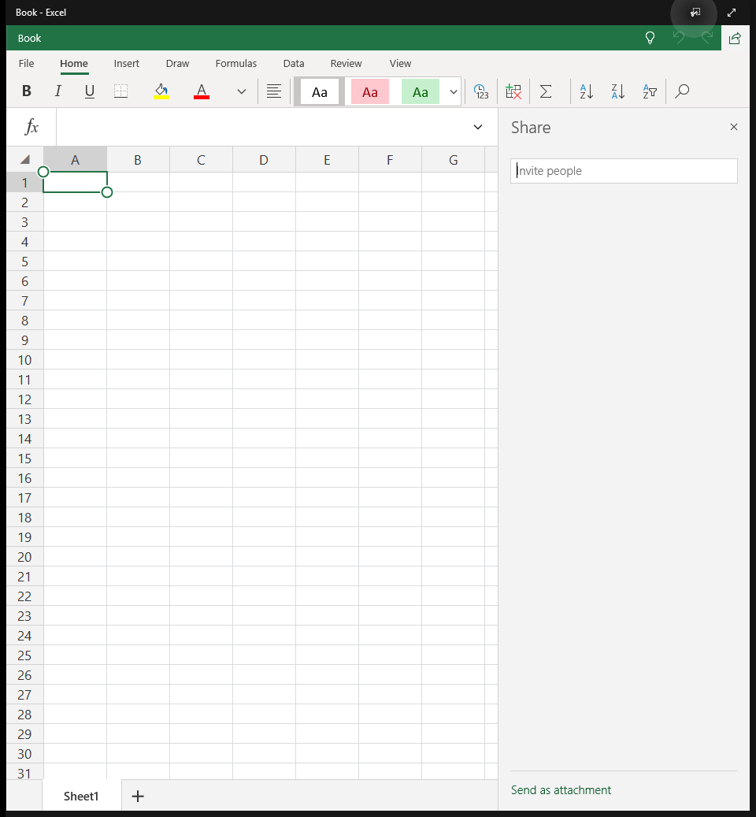
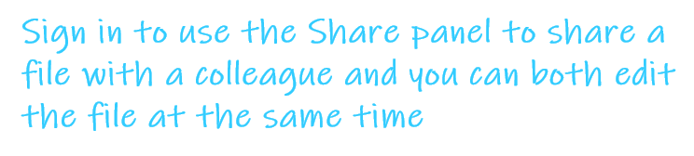
<- Back to Table of Contents

Slide 39
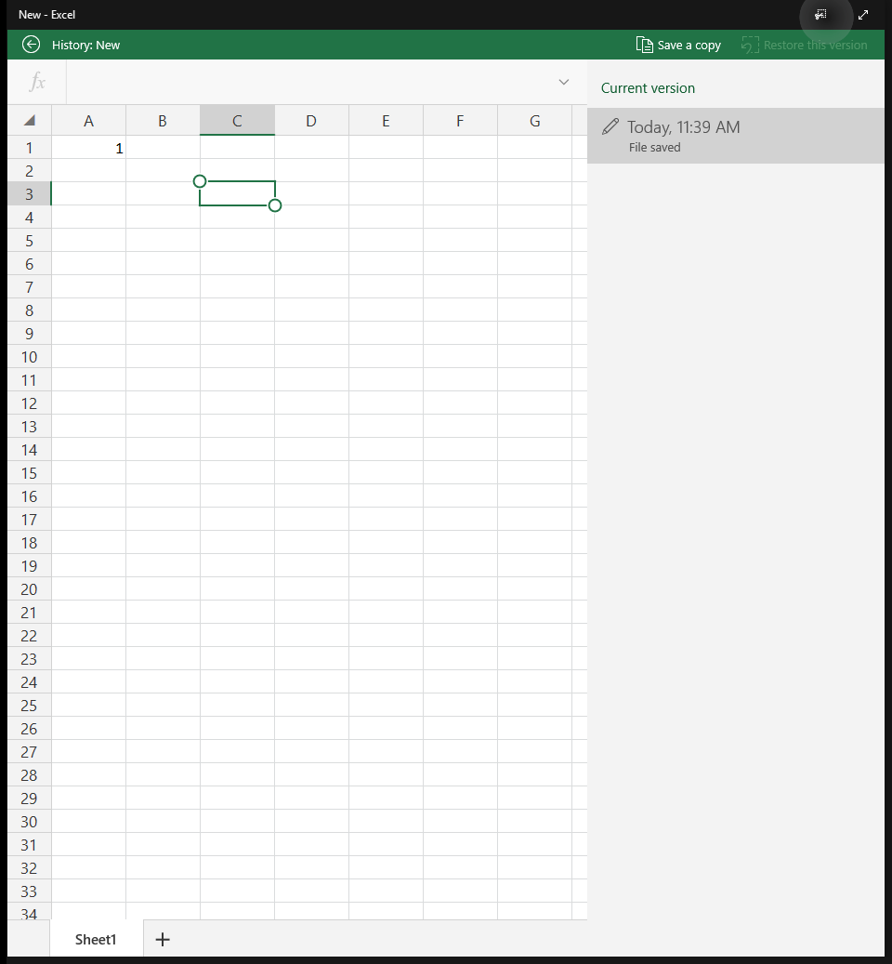

<- Back to Table of Contents

Slide 40
Microsoft Word
<- Back to Table of Contents

Slide 41
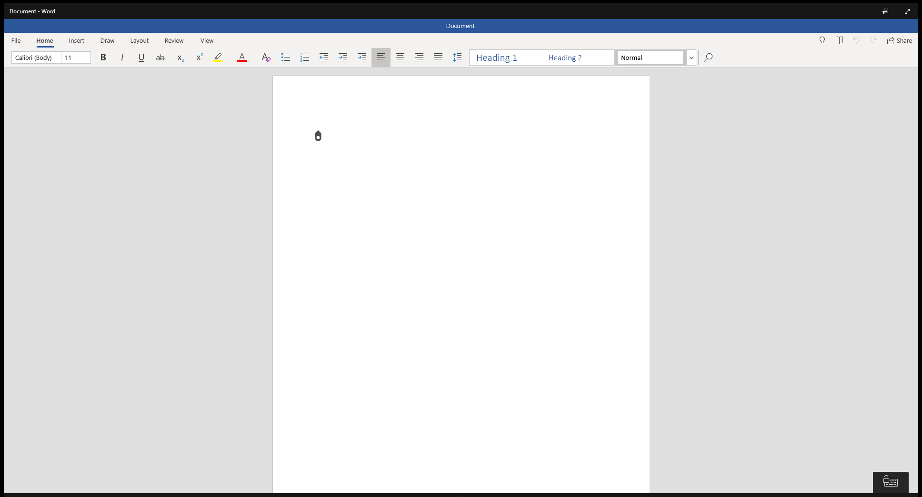

<- Back to Table of Contents

Slide 42

<- Back to Table of Contents

Slide 43
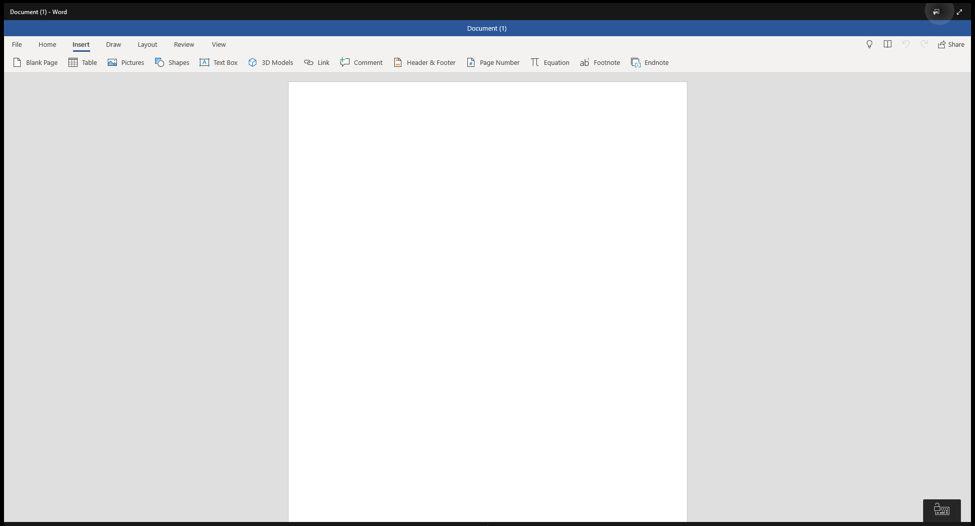

<- Back to Table of Contents

Slide 44
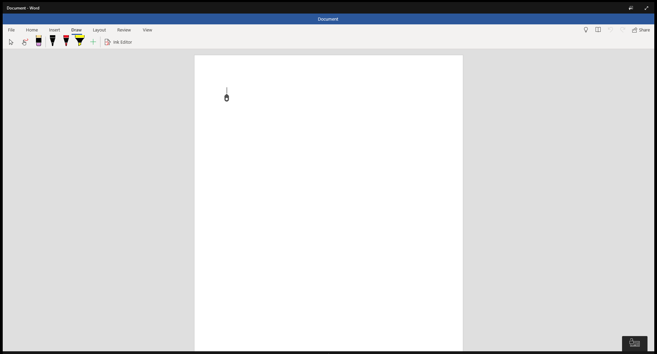

<- Back to Table of Contents

Slide 45
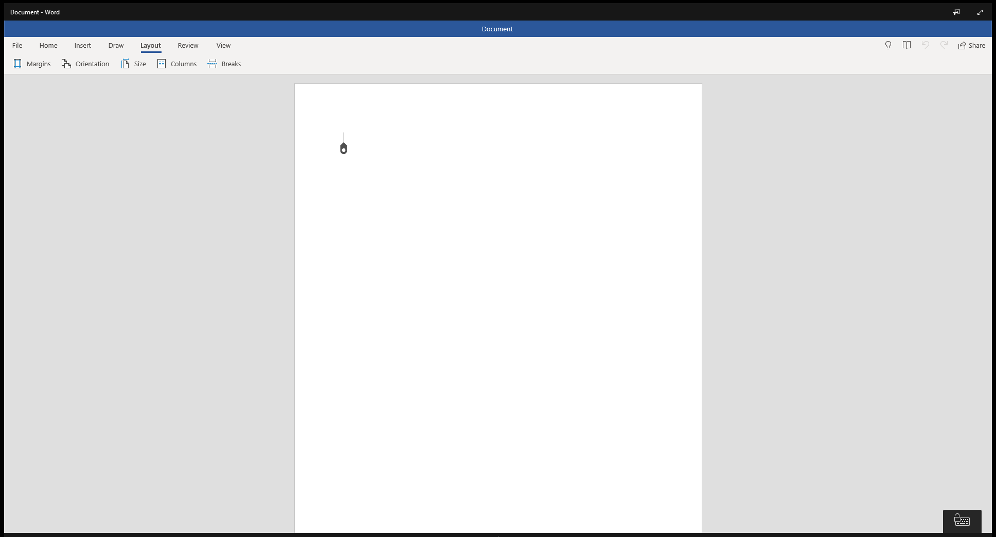

<- Back to Table of Contents

Slide 46
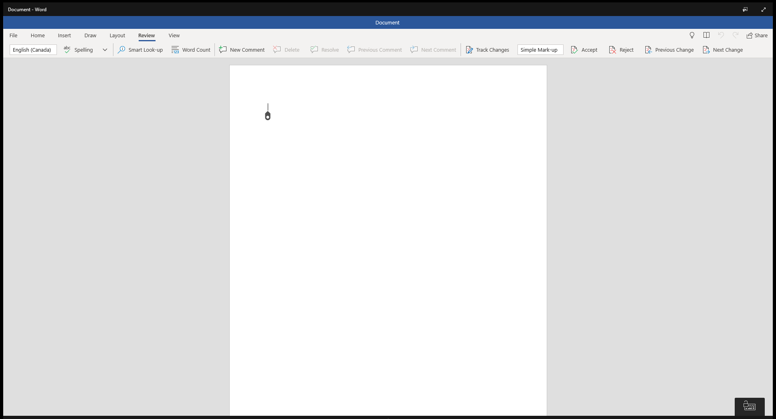
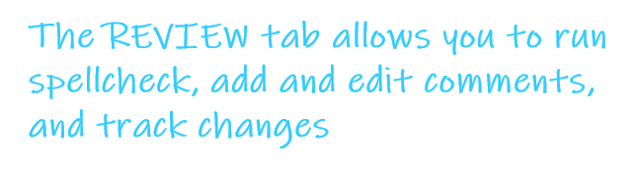
<- Back to Table of Contents

Slide 47
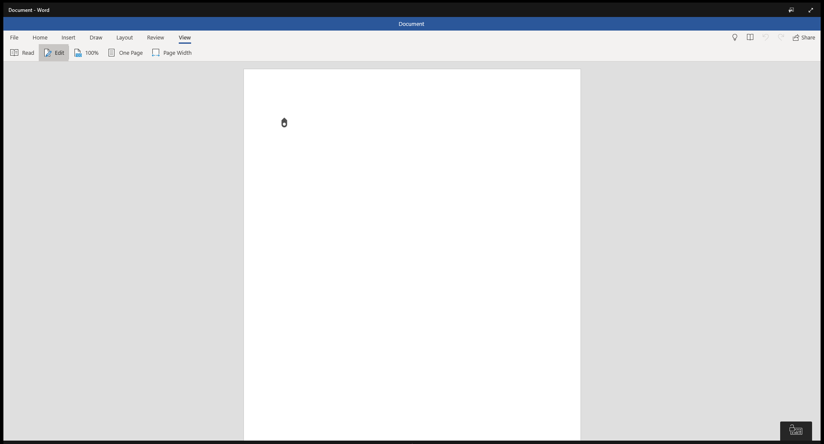

<- Back to Table of Contents

Slide 48
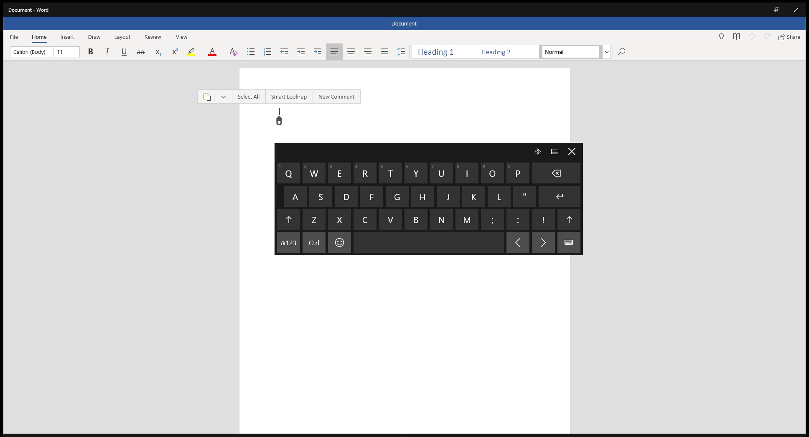

<- Back to Table of Contents

Slide 49
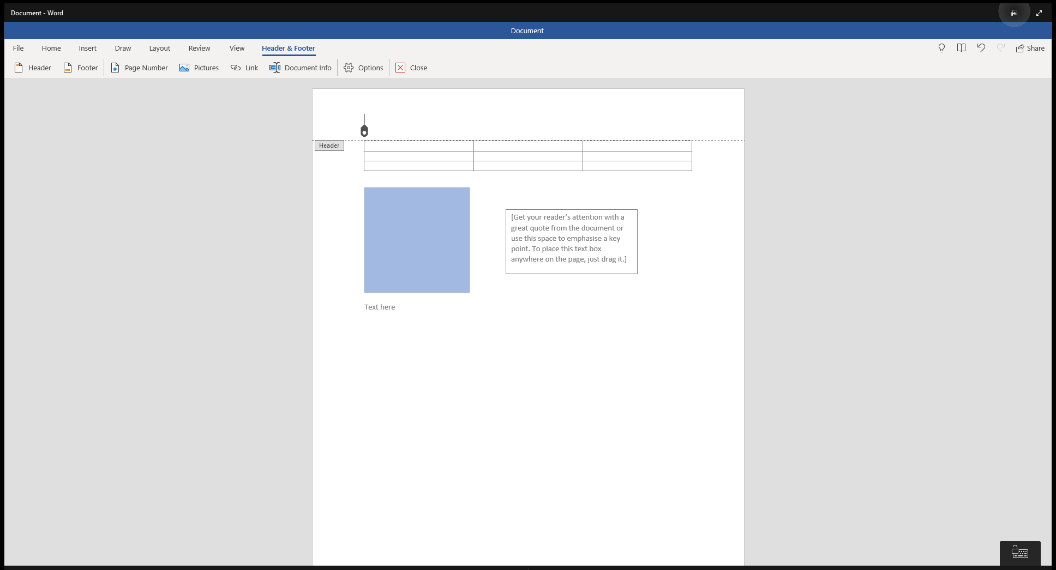

<- Back to Table of Contents

Slide 50
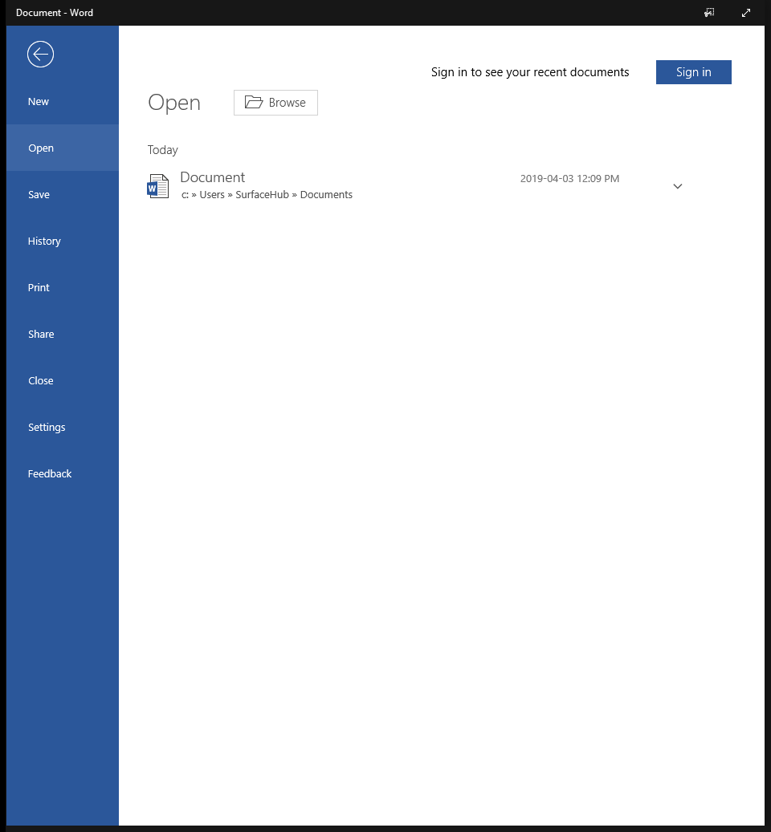
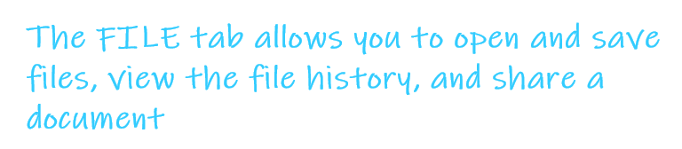
<- Back to Table of Contents

Slide 51
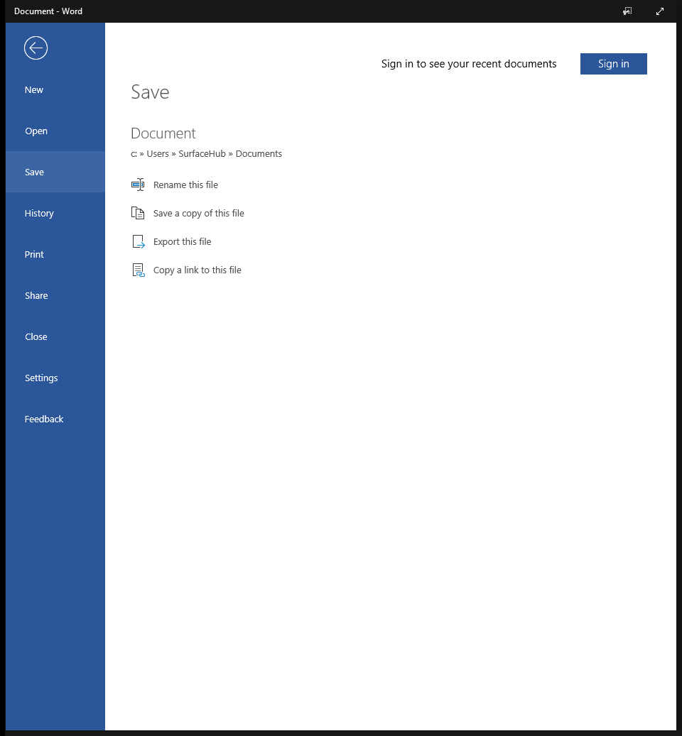

<- Back to Table of Contents

Slide 52
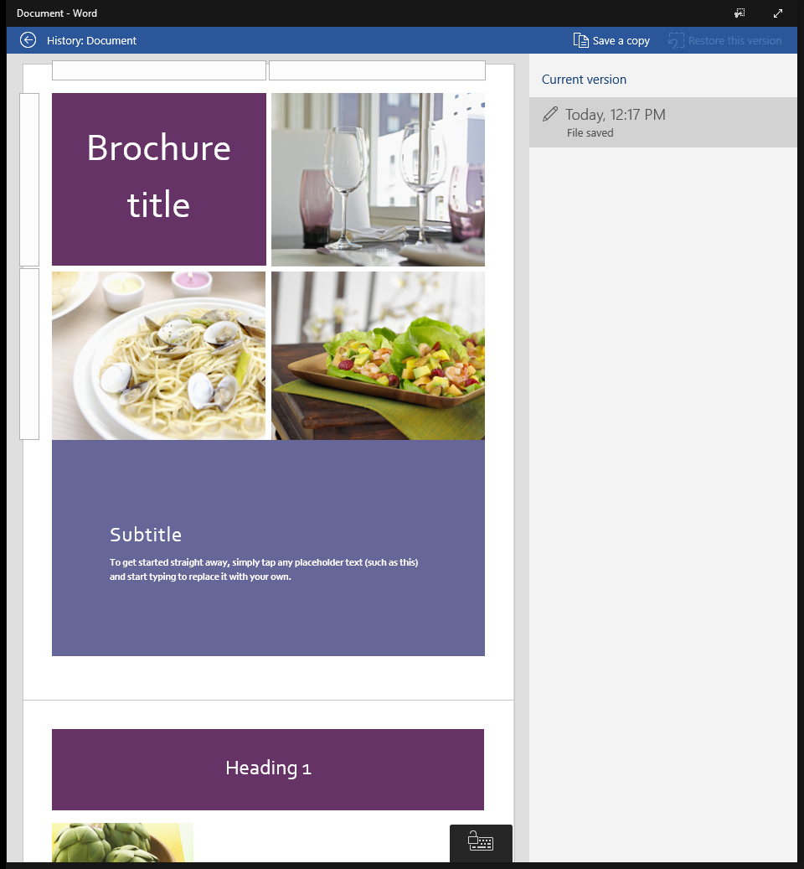
<- Back to Table of Contents

Slide 53
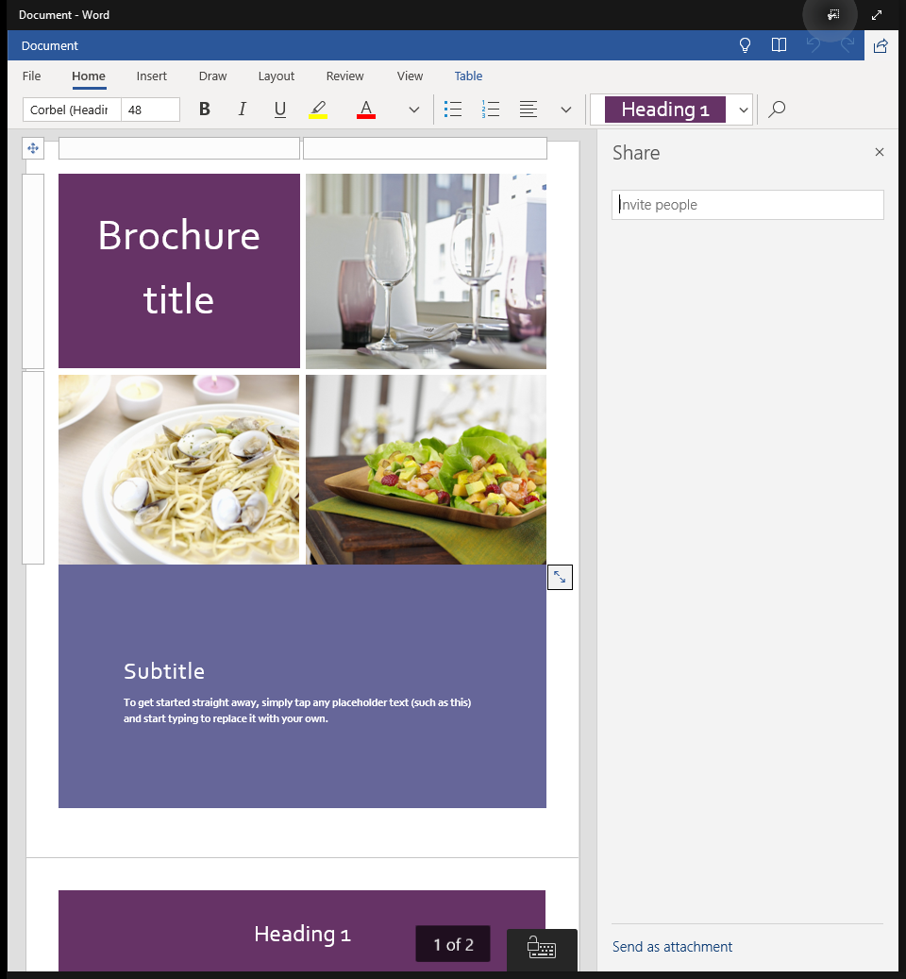
<- Back to Table of Contents

Slide 54
Microsoft OneDrive
<- Back to Table of Contents

Slide 55
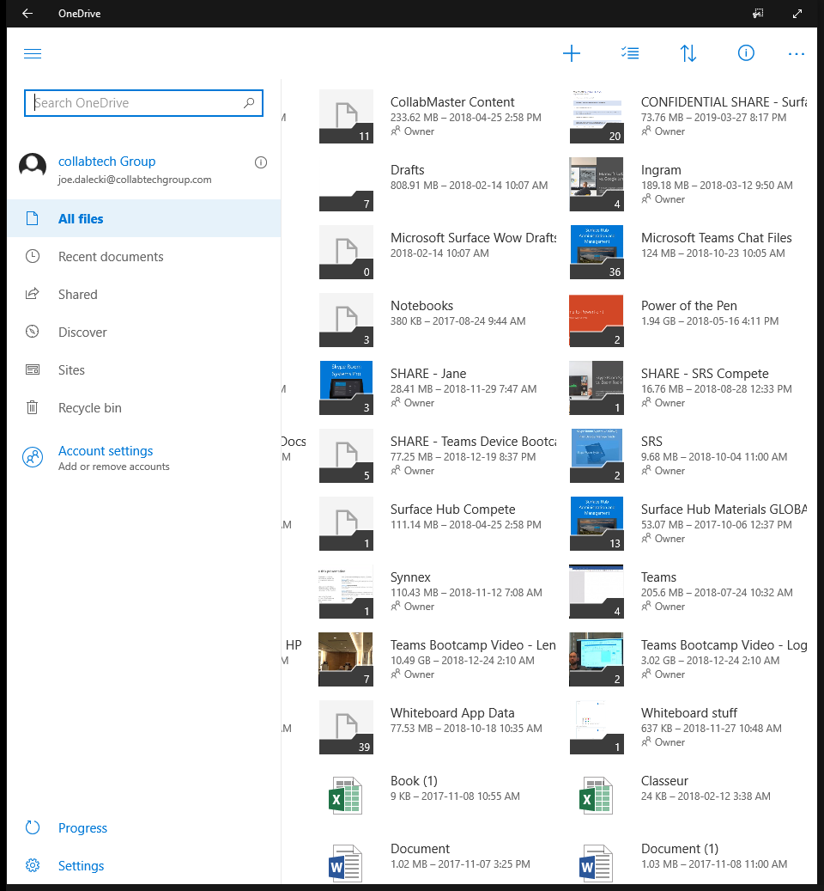

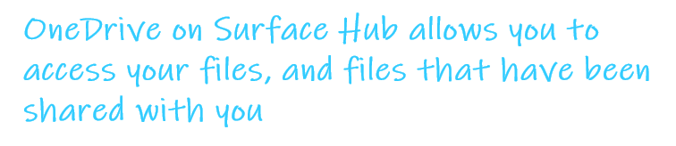
<- Back to Table of Contents
Contoso
tom.davis@contoso.com

Slide 56
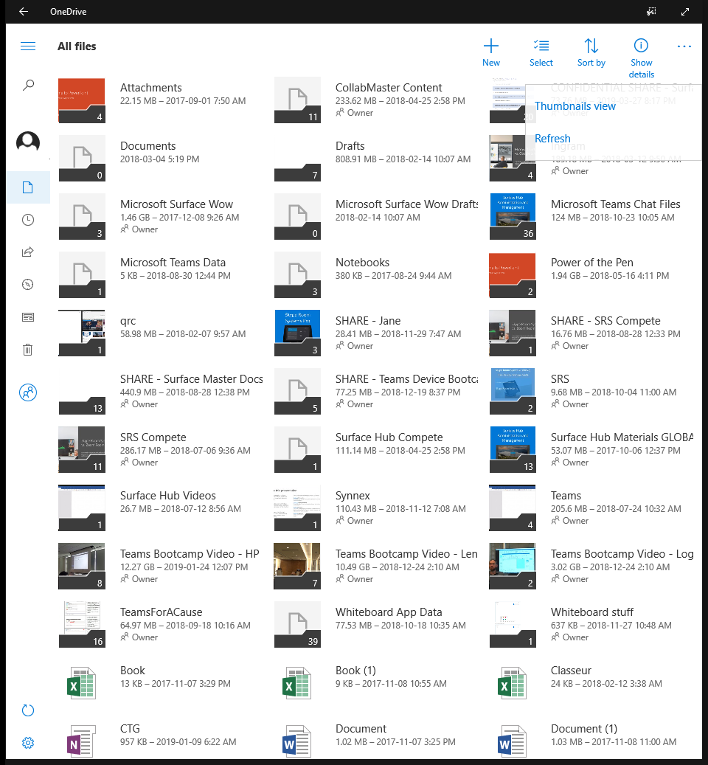



<- Back to Table of Contents

